Slide 1

@zinecat
Zine Union Catalog
2018: Past & Future

Slide 2

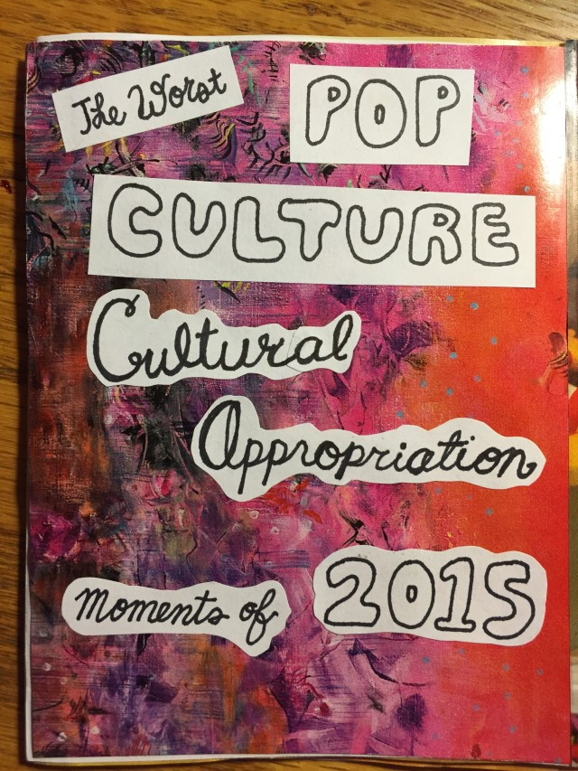
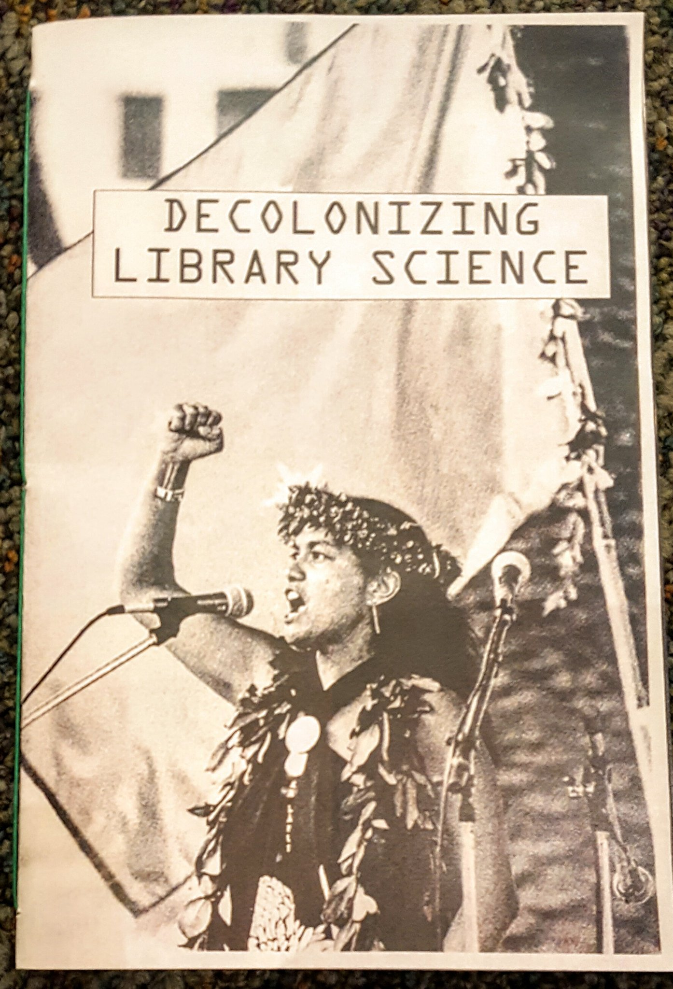
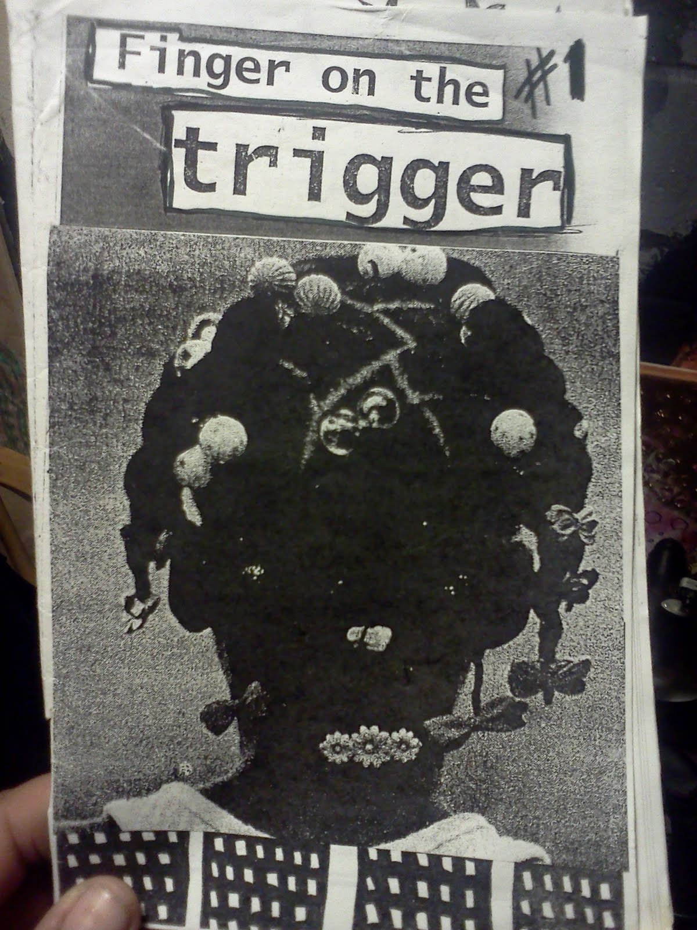
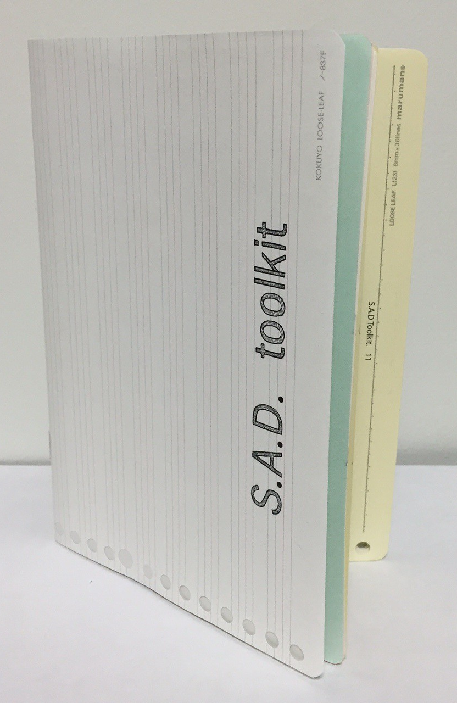
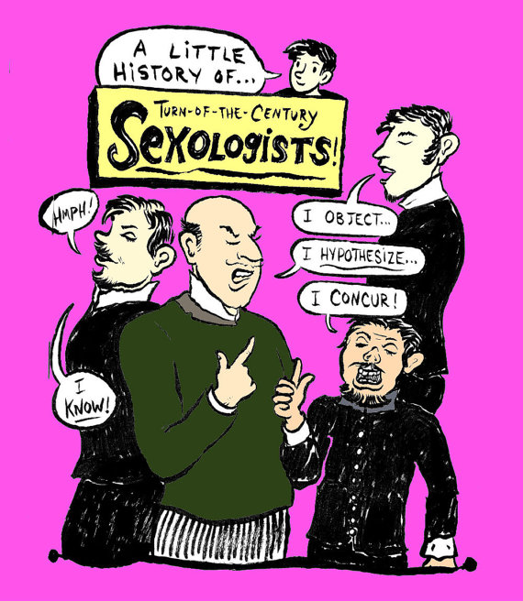
@zinecat
Intro to Zines
Notes:
ONE MINUTE - JENNA
Problem Statement
Zines: low distribution, self-publications in an anarcho-punk do-it-yourself tradition, though not widely held in libraries are held in a wide diversity of libraries.
Zines are created by people who don't normally have a place on library shelves--young people, people without academic or journalistic credentials, and poor people. All written and unmediated by publishers, editors, journalists, scientists, or people wanting to make money from the work.
Zines are written on topics that don't normally have a place on library shelves--menstrual extraction, self-injury, blackness, whiteness, single parenting while punk, a Taishin grandma, safer-sex for trans women, polyamory, and more, all written for a peer audience.
The range of libraries with zines includes traditional academic and public libraries, but also un- and underfunded DIY spaces that do not use standardized cataloging methods.
We aim to build a shared catalog that will bring together diverse libraries, cataloging standards, and zines.

Slide 3
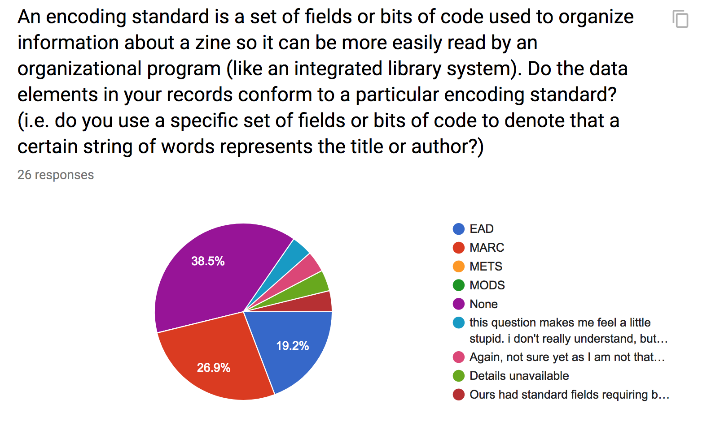
Shared Authority
@zinecat
Notes:
Jenna - ONE MINUTE
ZineCoreX - Standardized metadata.
Issue / problem of non standardized data.

Slide 4

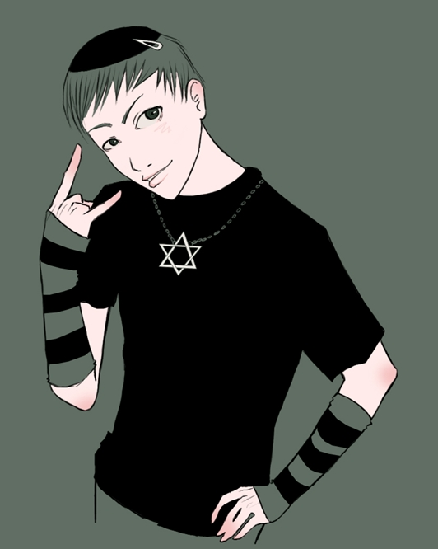

@zinecat
Zine Union Catalog
Notes:
One minute - JENNA
Aphra Squirrel is a professor of media studies writing a book on feminism and zines. She is just beginning her research and casting a wide net to see what types of zines are out there. The Zine Union Catalog helps her identify zine collections with relevant holdings. Dr. Squirrel visits multiple zine libraries and archives and becomes enraptured by zine description and access points. She ultimately writes a chapter in her book about zine cataloging as feminism praxis.
Miguel Cohen is writing a book on Jews in punk. Not expecting much, he conducts a cursory search in WorldCat to see if there are zines he should consider. He is astonished by the number of results and writes a whole chapter of his book on Jewish punk zines. However, he misses entirely zines from zine libraries not included in WorldCat, including the Queer Zine Archive Project, the Denver Zine Library, and libraries that do not have online catalogs. Devastatingly, Cohen's book will lack references to half a dozen radical trans Haggadahs that he would have found if he'd used ZUC.
Sea S. is an adult now, but when they were a teen they were kicked out of their house for being queer. Sea's dad disposed of their zine collection. They don't know how and they don't want to know. Finding and visiting the zines of their youth that helped them understand their genderfluid and queer identities and build community around them helps them make peace with what they lost. By being able to find and access the zines that formed them after twenty years, they have even come to a detente with their father.

Slide 5


@zinecat
It's like a WorldCat or DPLA for zines!
Notes:
TWO MINUTES - LAUREN
It's like a WorldCat (or Digital Public Library of America) for zines.
Union catalog: one-stop place for finding out about zines & where they're held:
known & unknown item searches, e.g., transgender kids
But why should you care? Zines are made by people who are otherwise un(der)represented on library shelves due to
age, class, race, gender, sexuality, radical viewpoint
general lack of access to power
Even when these people are on a library shelf, it's usually as the subject of a journalist or scholar's work,
not under their own, unmediated agency.
Zinesters write for a peer audience
about political and social issues like racial justice, personal concerns like mental health and self-injury
share instructions on a range of topics including herbal remedies for menstrual cramps and home greywater reclamation.
OCLC is essentially the union catalog standard for libraries → 72k members.
DPLA’s development: 2010→ 2018 and their documentation for how they’ve developed is available on their Professional Community site: pro.dp.la

Slide 6
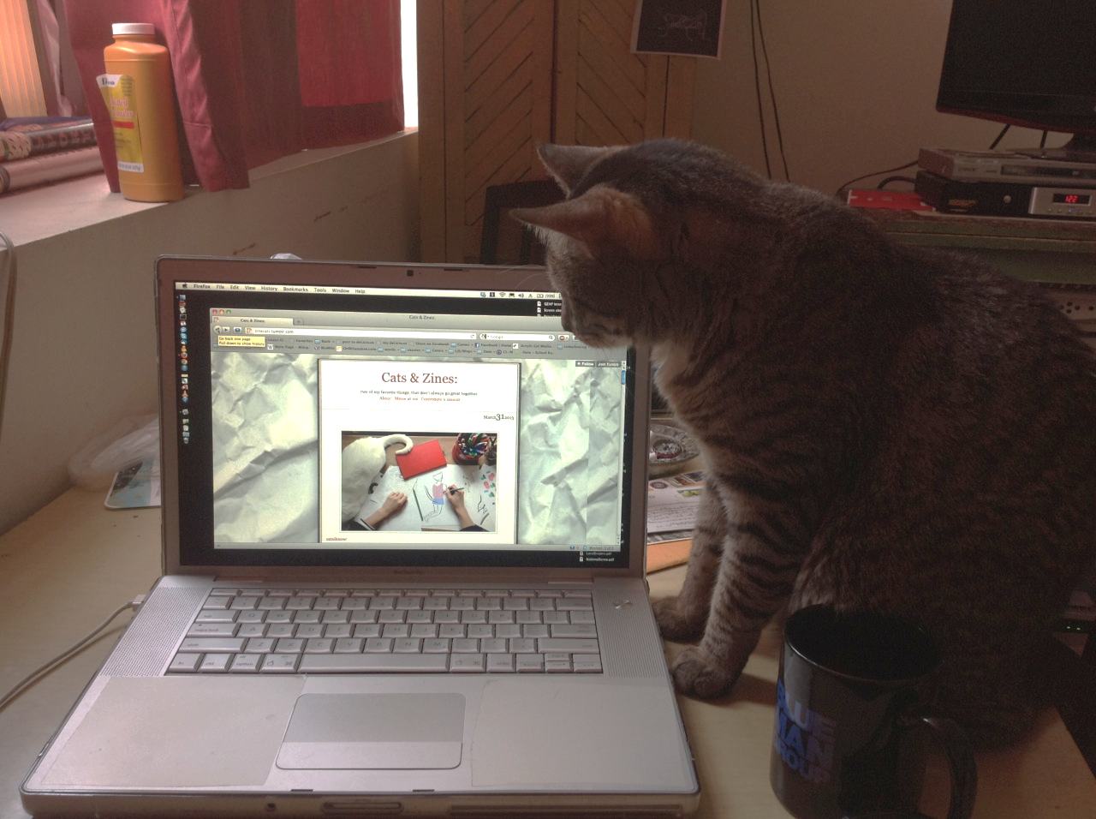
@zinecat
Strategic Planning
More records
More libraries
More fields
Mutual metadata (that's anarchist for "authority control")
Maybe some money
BUT, before we get there...
Notes:
THREE MINUTES - LAUREN
Add more records from current three collections and from more libraries (working list through ZineWiki).
We have records ready to upload in our GitHub repository from, among others
ABC No Rio, with a standalone database with a standalone metadata schema
Carnegie Library of Pittsburgh, which has been using LibraryThing as its catalog
Minneapolis Community and Technical College with another standalone catalog that uses ZINECORE
Ontario College of Art & Design with its records currently hosted on ARTstor
More sophisticated use of mutual metadata
Establishing authority files for creators
Subject thesaurus
leveraging linked open data--all about relationships now, and CA's strength is drawing out such relationships.
Zine Librarians group and ZineCat Group are in one email list-->working together
NEH DH Advancement Grant→to fund an in-person meeting to tease out points of unity (i.e, standardization) in cataloging while allowing each library or archive to maintain its unique identity.
Try us out...
Ultimate goal is to get ZineCat out there in the world, but there’s a bit of administrative work to be done first...and stuff for grad school.

Slide 7

@zinecat
Roadmap / Timeline
Spring ‘18
Prototype development on hold
Decision Making
Sustainability/Scaffolding
Communicate with working group & stakeholders
Summer ‘18: ZLUC
Fall ‘18
Workshops in NYC
Grant / Funding
Working group → steering committee
Project management software → organize documentation
What happens after ITP & the GC?
Notes:
Image credit: https://flic.kr/p/F5WUgs
Or use this photo: https://flic.kr/p/ouMKUw

Slide 8
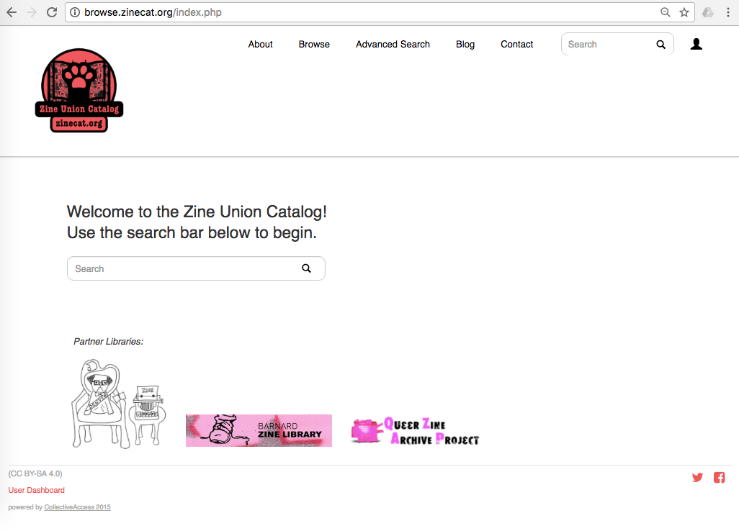
@zinecat
Notes:
JENNA
PROOF - TWO MINUTES TOTAL - JENNA
The ZineCat prototype takes 25ish records from three different collections.
Denver Zine Library - standalone cataloging system (spreadsheet)
Barnard Zine Library - MARC
Queer Zine Archive Project - xZINECOREx
Search - not much content, not much metadata, so most successful: queer
Browse

Slide 9
@zinecat
Prototype contents
Title
Author
Format of object (physical zine, audio zine, etc.)
Date Created
Location Created
Related Collection
External URL
Notes:
Jenna
Rn this is all we have, but eventually:
Subjects & abstracts, everything clickable.

Slide 10
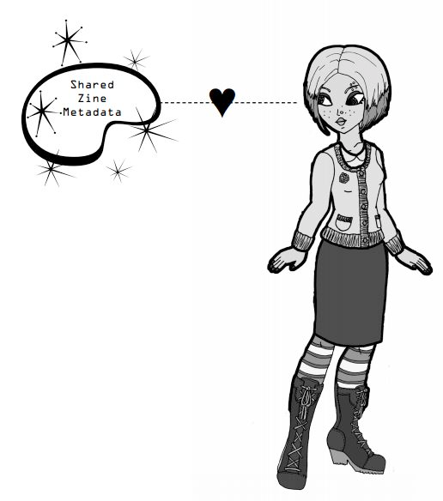
@zinecat
Credits & Links
Website zinecat.org
Email zinecatproject@gmail.com
Repository github.com/MiloQZAP/xZINECOREx
Collective Access collectiveaccess.org
Participating libraries
Barnard Zine Library zines.barnard.edu
Denver Zine Library denverzinelibrary.org
Queer Zine Archive Project qzap.org
Zine Union Catalog on zinelibraries.info zinelibraries.info/zine-union-catalog

